Slide 1
Lindy Effect and User Retention on Wikidata
Goran S. Milovanović
DataKolektiv, Owner/Data Scientist, WMDE
Jan Dittrich
UX Design and Research, WMDE
Martin Gerlach
Research Scientist, WMF Research

Slide 2
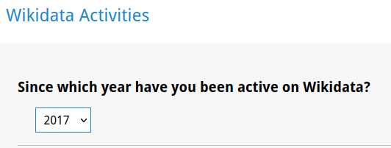
How it started
Wikidata Community Survey 2021
State of the Wikidata Community Survey

Slide 3
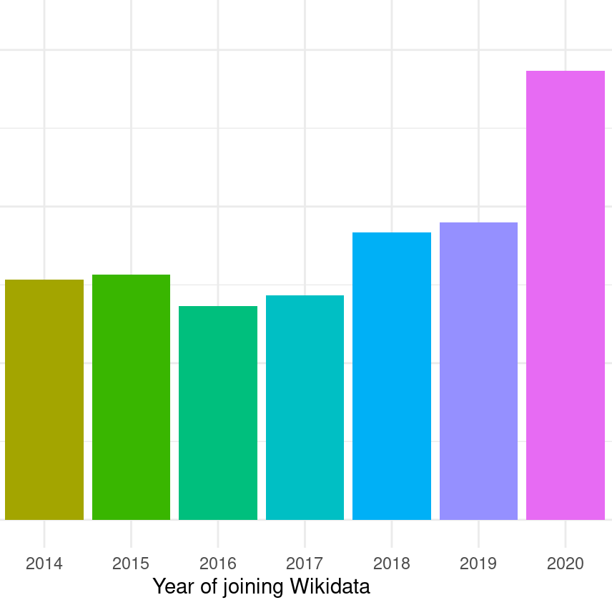
How it started
State of the Wikidata Community Survey

Slide 4
How it started
What about the account age?
For how long do editors stay with us to contribute?
State of the Wikidata Community Survey

Slide 5
Motivation
For how long to editors stay with us?
How can we retain editors?
How and when can we retain new editors?
  Which kind of new editors leave us and when?
Can we predict if and when an editor will leave the project?
Related to ongoing research around Wikipedia Editor retention – but there is few research on retention of Wikidata editors!
State of the Wikidata Community Survey

Slide 6
Do we observe a Lindy effect?
“The Lindy effect (also known as Lindy's Law^{[1]}) is a theorized phenomenon by which the future life expectancy of some non-perishable things, like a technology or an idea, is proportional to their current age.”
(Says Wikipedia)
Phabricator: User Retention Wikidata: A model for "participating since" patterns in the 2021 Wikidata Community Survey (T282563)

Slide 7
Do we observe a Lindy effect?
“The Lindy effect (also known as Lindy's Law^{[1]}) is a theorized phenomenon by which the future life expectancy of some non-perishable things, like a technology or an idea, is proportional to their current age.”
(Says Wikipedia)
This means:
retention time from now = p * retention time until now
Expected remaining account age
Account age at the time of observation (now)

Slide 8
Analysis
We have collected user revision histories for 399,967 users - everyone who ever registered on Wikidata -from the WMF Data Lake (wmf.mediawiki_history): from the beginning of time and until the most recent available data (Sep/Oct 2021).
Each user revision history is coded as a sequence of active and inactive (< 5 edits) months, e.g. 00111010101111110101010…).
Lengthy 0+$ sequences were edited to end in 00000$ e.g. 001110101011111100000000000000.
If a user revision history ends in five or more consecutive months of inactivity, we say that the user has left Wikidata.
Of course, users sometimes leave and then return: we count the number of user reactivations.
We count the number of active months in each user’s revision history: total user activity.
Variables

Slide 9
Analysis
Users are very likely to stop editing: we’ve found that the probability to stop editing is 0.92
Only 8% 400K users who have ever registered in Wikidata were active at the time of analysis.
In the next slide we show that this probability of .92 heavily depends upon user revision history.
How likely are users to leave Wikidata?

Slide 10
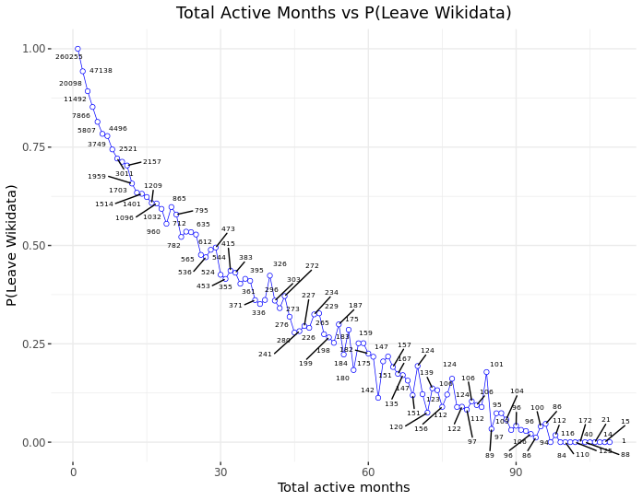
Analysis
Left Wikidata
How likely are users to leave Wikidata?
Still contributing
Editing rarely
Tons of frequent edits

Slide 11
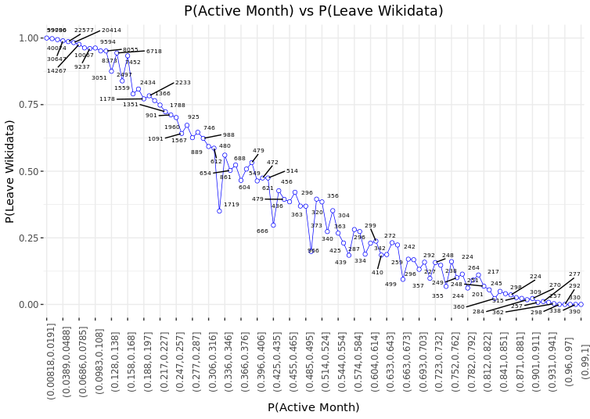
Analysis
Left Wikidata
How likely are users to leave Wikidata?
Still contributing
num. active months/num. total months (account age)

Slide 12
Analysis
Lindy Effect or not?
If the Lindy effect holds than the Survival function of the account age is Pareto.
Eliazar, I. (2017). Lindy’s Law. Physica A: Statistical Mechanics and its Applications. Vol. 486, 15 November 2017, pp. 797-805.
Hence we need to test if the Wikidata account age follows a power-law or not!
Lindy Effect

Slide 13
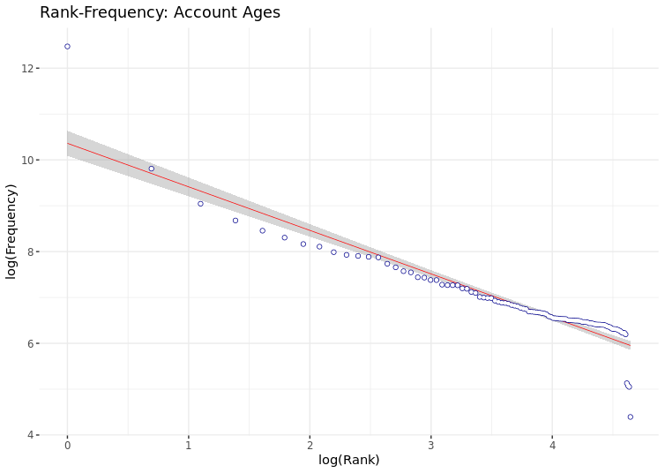
Analysis
Lindy Effect or not?
For ACCOUNT AGE
Lindy Effect
Frequency: how often do we observe an account age of N months?
Rank: we simply rank the frequencies, assigning ordinal numbers: 1, 2, 3,..
log(Rank) vs log(Frequency) plot is linear if a power law holds.

Slide 14
Analysis
Lindy Effect or not?
For ACCOUNT AGE
{poweRlaw} R package (based on: Clauset. A., Shalizi, C. R. & Newman, M. E. J. (2009). Power-Law Distributions in Empirical Data. SIAM Rev., 51(4), pp. 661–703.)
Method A
Method B
Estimate x_{min}
Take empirical x_{min}
H₀: Power law
H₁: Not a power law
x_{min}= 7
ɑ = 1.78
Bootstrap p (1000 sims)
p = 0
Result: NOT a power law
x_{min}= 6
ɑ = 2.81
Bootstrap p (1000 sims)
p = 0
Result: NOT a power law
Lindy Effect

Slide 15
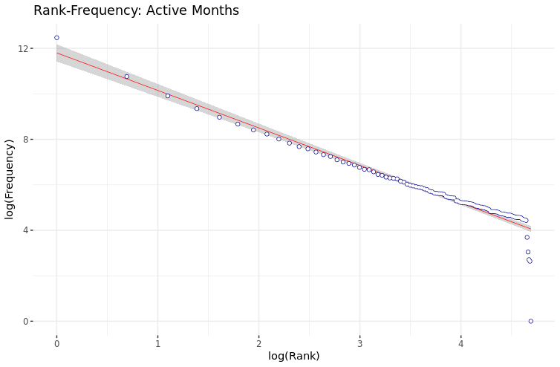
Analysis
Lindy Effect or not?
For ACTIVE MONTHS only
Lindy Effect
Frequency: how often do we observe an account with N active months months?
Rank: we simply rank the frequencies, assigning ordinal numbers: 1, 2, 3,..
log(Rank) vs log(Frequency) plot is linear if a power law holds.

Slide 16
Analysis
Lindy Effect or not?
For ACTIVE MONTHS only
Clauset. A., Shalizi, C. R. & Newman, M. E. J. (2009). Power-Law Distributions in Empirical Data. SIAM Rev., 51(4), pp. 661–703.
Method A
Method B
Estimate x_{min}
Take empirical x_{min}
H₀: Power law
H₁: Not a power law
x_{min}= 2
ɑ = 1.82
Bootstrap p (1000 sims)
p = 0
Result: NOT a power law
x_{min}= 1
ɑ = 1.98
Bootstrap p (1000 sims)
p = 0
Result: NOT a power law
Lindy Effect

Slide 17

Analysis
Lindy Effect or not?
Well, no.
But this does not mean that
people who are editing since a long time are not less likely to leave, or that
newcomers do not have the highest probability to drop out.
This means only that a particular scaling is not present:
Lindy Effect
Expected remaining account age
T - t...
… given that the user is already around for more than t months.
(with T following a power-law distribution with ɑ = 1 + 1/p)

Slide 18
Analysis
User Retention
Can we predict if a user will “stay” or “leave”, given their user revision histories and additional features?
XGBoost for Binary Classification
FEATURES
Number of user reactivations
H - The Shannon Diversity Index (i.e. the entropy present in the distribution of active/inactive months, scaled)
Account age (months)
Number of active months (months)
P(Active Month)
Number of revisions - content NSs
Number of revisions - talks NSs
Average number of revisions per month - content NS
Average number of revisions per month - talk NSs
Mean length of inactivity periods (months)
Median length of inactivity periods (months)
User Retention

Slide 19
Analysis
User Retention
XGBoost for Binary Classification
TRAINING
Split into train and test dataset
Heavy downsampling and upweight in the training dataset because of huge class imbalance
Search through a very constrained parameter space, cross-validation across eta, max_depth and subsample only
Shallow trees (max_depth = 5 or 10), lots of them (n_rounds = 10,000)
User Retention

Slide 20
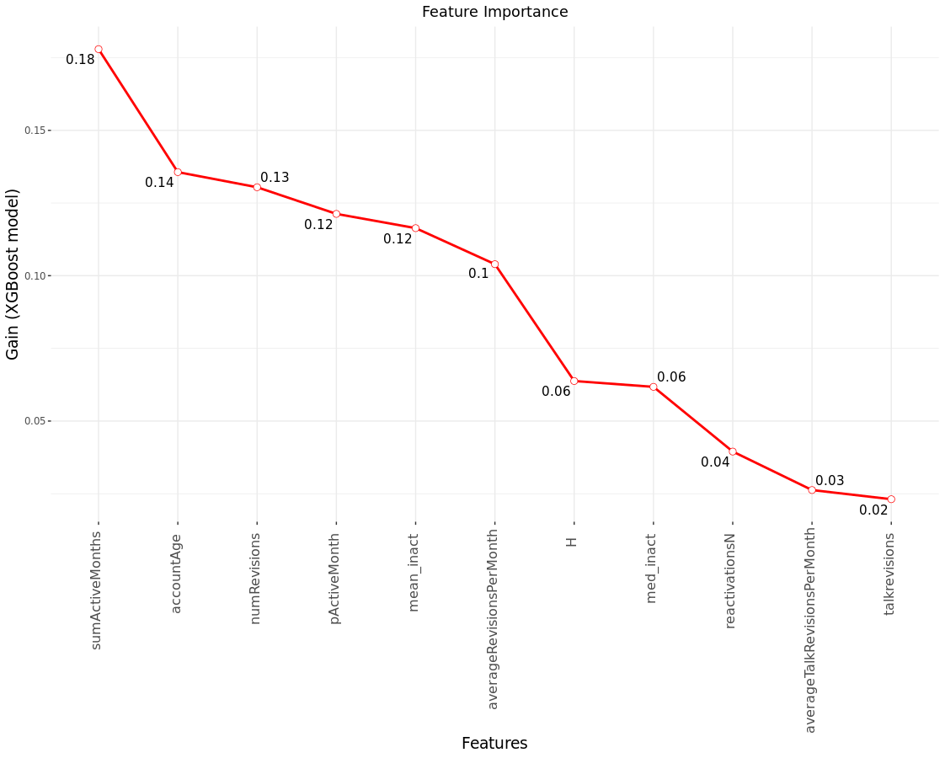
Analysis
User Retention
XGBoost for Binary Classification
FEATURE IMPORTANCE
User Retention

Slide 21
Analysis
User Retention
Can we predict if a user will “stay” or “leave”, given their user revision histories and additional features?
XGBoost for Binary Classification
RESULTS
TPR = 0.91, FNR = 0.09
FPR = 0.10, TNR = 0.90
AUC = 0.969 - a bit better than currently the best model of Wikidata user retention that was reported in the literature (c.f. the DeepFM approach - but the authors used a different “leave” criterion then we did, so the models are not really comparable)
Bayesian analysis, starting from P(User Leaves) = .92, shows that P(User leaves|Model says user will leave) = .99
User Retention

Slide 22
Code/Data
GitHub
https://github.com/wikimedia/analytics-wmde-WD-WikidataAdHocAnalytics/tree/master/WD_UserRetention
01_WD_userRetention_ETL.R - extract raw data from the wmf.mediawiki_history from Hadoop (denormalized revision history, all WMF projects); available (dumps) from WMF Analytics Datasets
02_WD_userRetention_Analytics.R - data pre-processing, visualizations, power-law hypothesis testing, XGBoost model
Data (in the repo)
WD_UserRetention.csv - raw dataset used to extract user revision histories; user IDs are anonymized
WD_UserRetention_TalkRevisions.csv - raw dataset, revisions in the talk namespaces; user IDs are anonymized and matched with WD_UserRetention.csv
These two datasets are used in 02_WD_userRetention_Analytics.R to produce all analytics datasets used in the study

Slide 23
Questions

